Slide 1



Apache PySPARK
+
=
3
Video-

Slide 2
Playlist Agenda
What is SPARK ? & Its Architecture
What is Pyspark ?
Why Do we need It ?
Difference Between Hadoop and Spark ?
Difference Between Pandas and Pyspark ?
Setting up Spark in Our Local Environment ( installation )
Starting the Pyspark in IDEs (Jupyer Notebook orPycharm )
Applications of Pyspark
Machine Learning Examples using Pyspark using Large Datasets

Slide 3
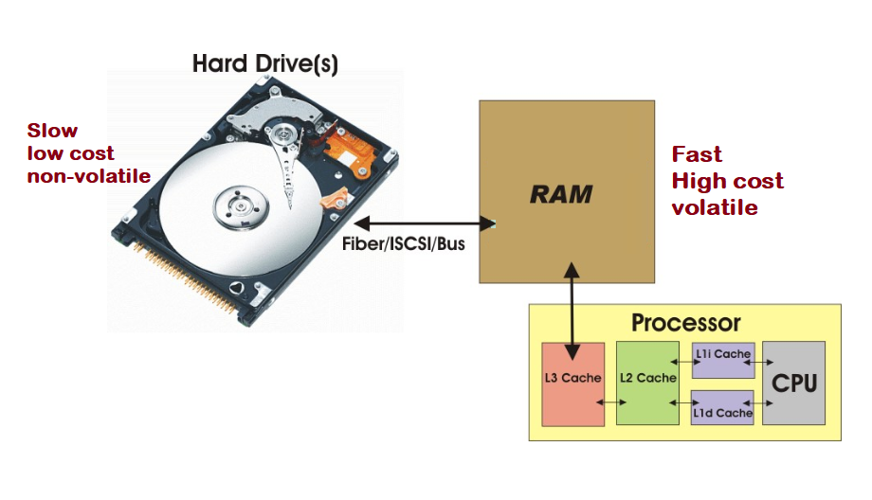
Data Flow from Storage to CPU ( Processor )

Slide 4
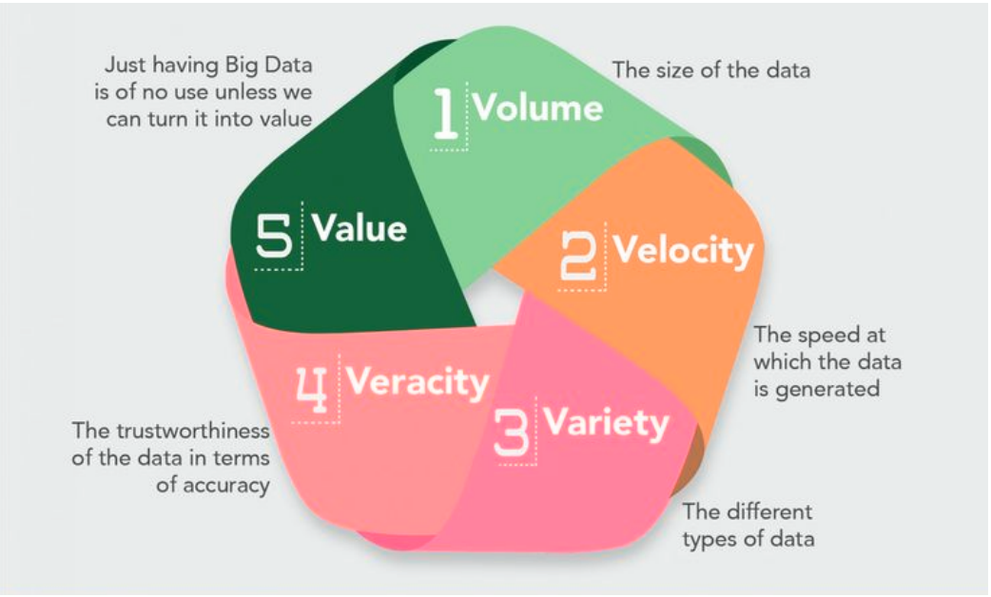
5v of Big Data

Slide 5
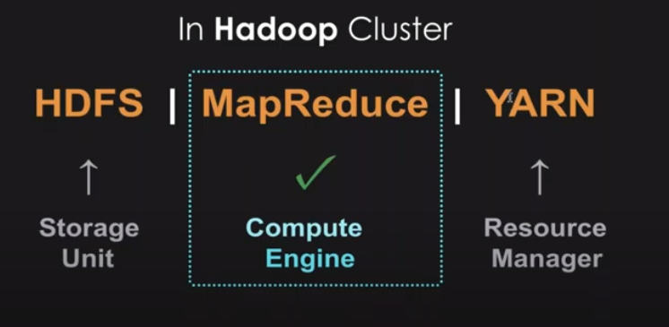
Big data is the Problem Hadoop is the solution

Slide 6
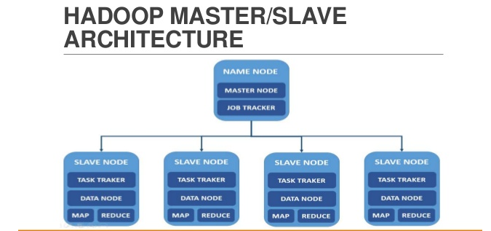

Slide 7

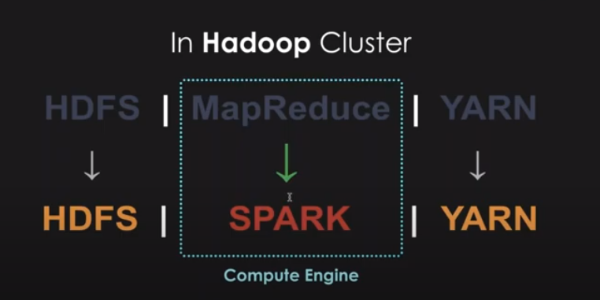
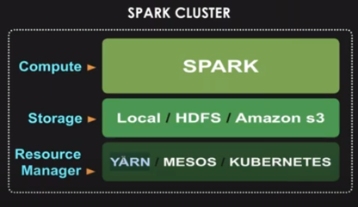


Slide 8
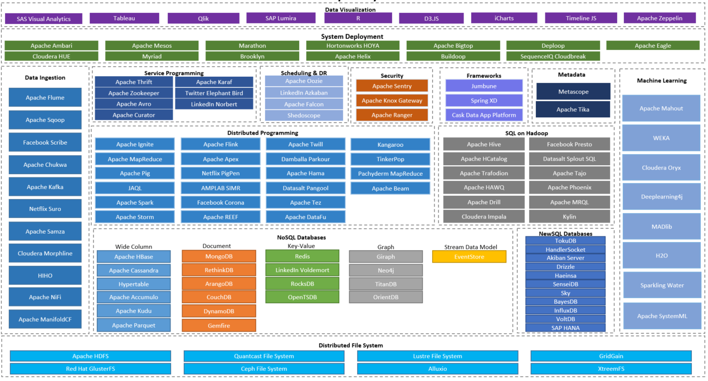
HADOOP ECOSYSTEM

Slide 9
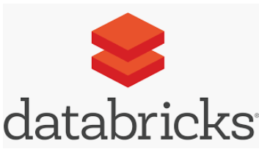
What is Spark ?
lightning-fast real-time processing framework, Written in Scala (JVM).
For python interface, Py4J library is used
in-memory computations, Lazy execution and Parallel Processing
Apache Hadoop MapReduce was performing batch processing only and lacked a real-time processing feature. Spark does Batch and Real time processing
It leverages Apache Hadoop for both storage and processing. It uses HDFS (Hadoop Distributed File system) for storage and it can run Spark applications on YARN as well.
Spark can load data directly from disk, memory and other data storage technologies such as Amazon S3, Hadoop Distributed File System (HDFS), HBase, Cassandra

Slide 10


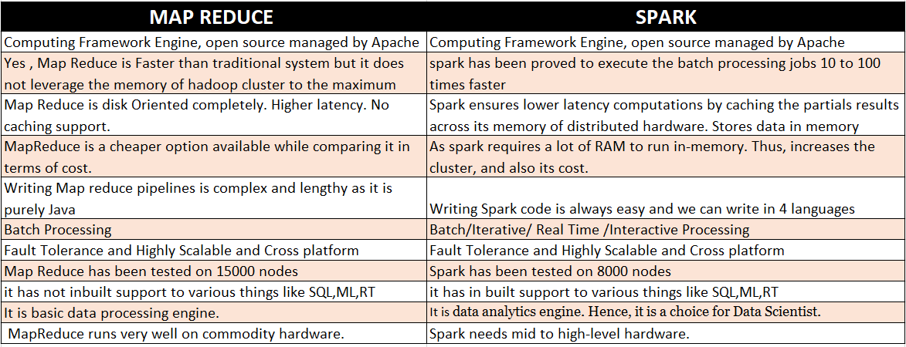

Slide 11

Apache Spark community released a tool, PySpark.
PySpark is the Python API written in python to support Apache Spark.
It lets us use the power of Apache Spark in order to tame Big Data.
It is because of a library called Py4j that they are able to achieve this.
To use PySpark you will have to install python and Apache spark on your machine.
Using PySpark, we can work with RDDs in Python programming language also.

Slide 12



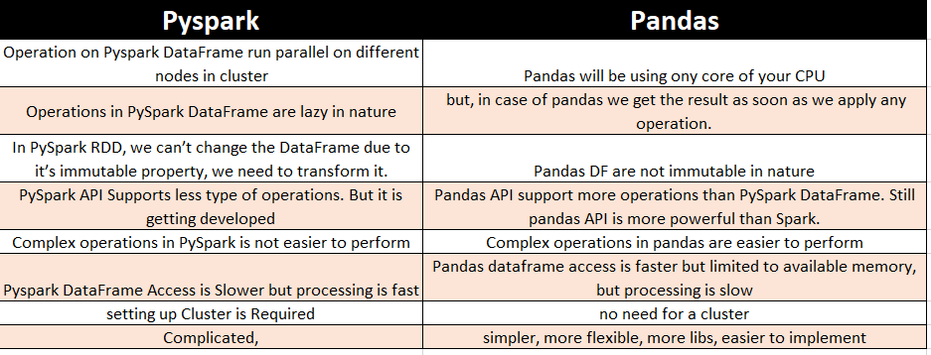

Slide 13
Resilient Distributed Dataset,
Fundamental Unit of Pyspark/Spark.
Resilient: It is fault tolerant and is capable of rebuilding data on failure.
Distributed: Data is distributed among the multiple nodes in a cluster.
Dataset: Collection of partitioned data with values.
Immutable and follows Lazy transformation
these are the elements that run and operate on multiple nodes to do parallel processing on a cluster
You can apply multiple operations on these RDDs to achieve a certain task.
Spark RDD can also be cached and manually partitioned.
Two Operations :
            Transformation : to create a new RDD (e.g. Filter, groupBy and map)
            Action : instructs Spark to perform computation and send the result back to the driver.

Slide 14
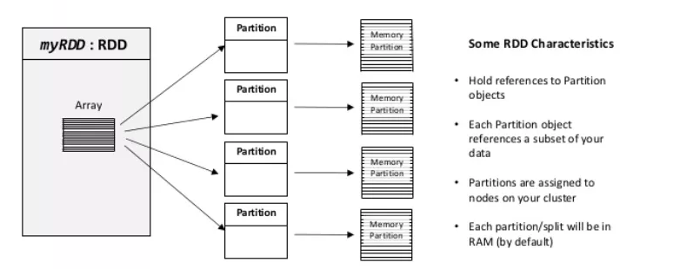
RDD

Slide 15
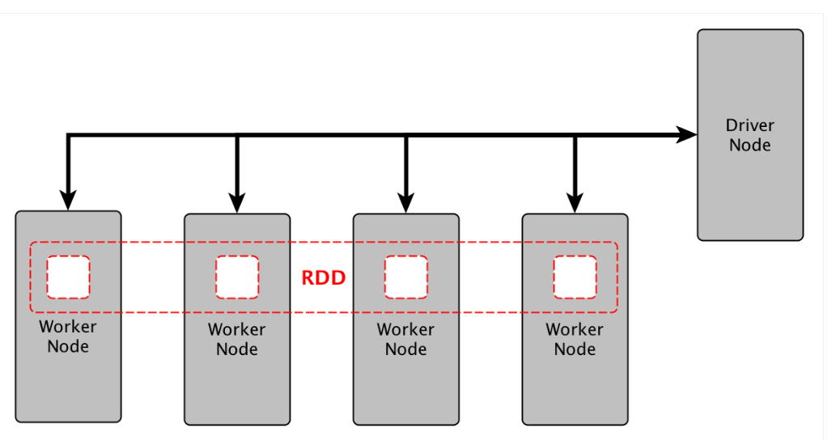

Slide 16
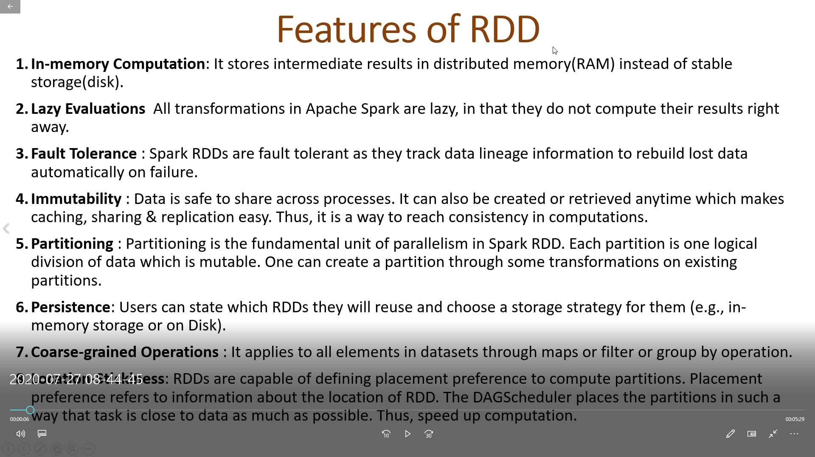
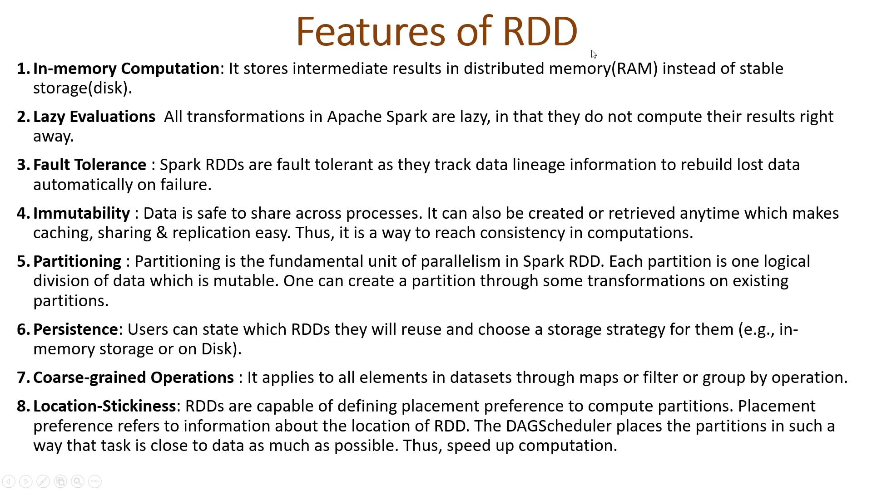
Features of RDD

Slide 17
Installing Spark in Local Environment
If you find the right guide, it can be a quick and painless installation. But since its fast evolving infrastructure, methods and versions are dynamic, and a lot of outdated and confusing materials out there.
Another set of problems come from winutils.exe file,which an hadoop component for Windows OS.

